Slide 1

Real-Time Gesture-Driven Alert System for Enhancing Women’s Safety
Introducing G-Net: an AI-driven, proactive safety system for women.

Slide 2

Why G-Net?
Current Limitations
Manual SOS Web-App
Traditional CCTV lacks real-time intelligence and needs human monitoring.
Require user input, which may be impossible in emergencies.
Need for Proactive Safety
System detects distress automatically and alerts authorities instantly.

Slide 3

Core Technologies Surveyed
Gesture Recognition
Surveillance Systems
Uses CNNs and MobileNet for hand gesture classification.
Current systems lack contextual understanding of distress signals.
Facial Detection
FaceNet and YOLOv5 provide high accuracy in face recognition.

Slide 4
Datasets for Training
Hand Gesture Dataset
WIDER FACE Dataset
Adience Dataset
Custom Real-Time Capture
Facial images labeled by gender and age for classification.
20,000+ labeled images showing distress gestures in varied conditions.
Faces with different angles, occlusions, and lighting for detection training.
Simulated environments like metro stations and alleys for fine-tuning.

Slide 5

Gesture Recognition Module
Key Gestures
Model Optimization
Open hand for "Help"
MobileNetV2 ensures real-time performance on edge devices.
Two-handed wave distress signal
Palm outward "Stop" signal
Data Augmentation
Rotation, zoom, and contrast improve model generalization.

Slide 6
Facial Detection & Classification
Detection
Enhancement
Classification
YOLOv5 and Haar Cascades detect faces and crop regions.
Histogram equalization improves low-light image quality.
Gender and identity classified using CNN and facial embeddings.

Slide 7
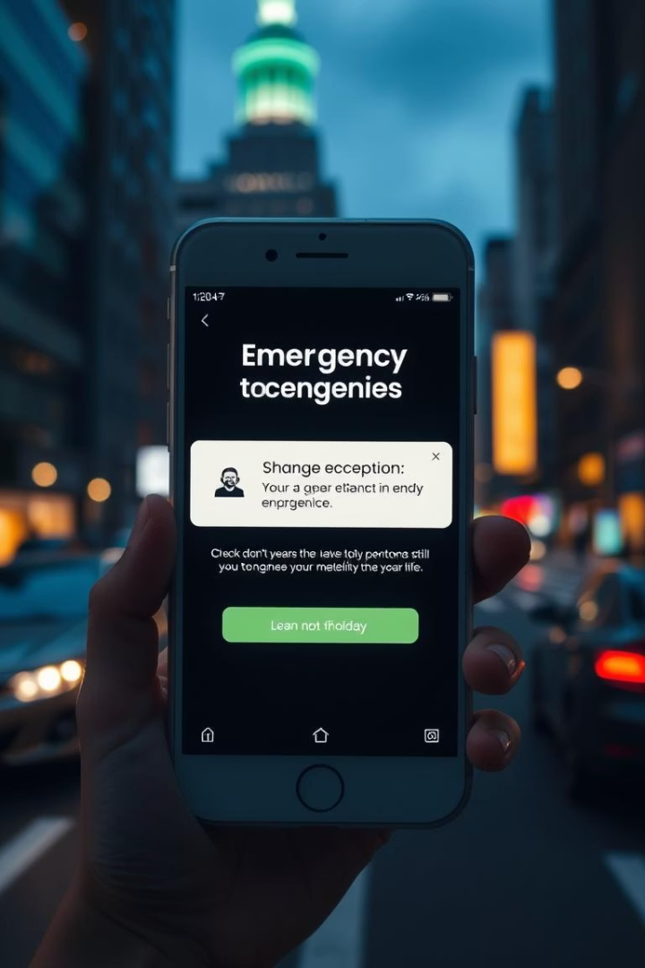




Alert System Workflow
Detect Gesture
System recognizes distress signals automatically.
Capture Faces
Extracts faces and metadata from the scene.
Send Alert
Posts images and info to emergency response API.
Notify Authorities
Local security receives instant mobile alerts.

Slide 8
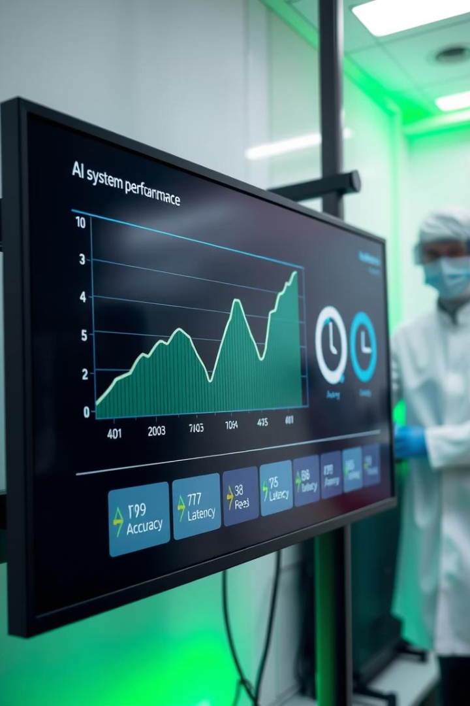
Performance & Testing Results
Module
Accuracy
Latency (ms)
Gesture Recognition
94.2%
200
Face Detection
89.1%
180
Gender Classification
91.3%
150
Alert Dispatch
-
<1000
End-to-end response time is 1.5 seconds, suitable for real-time use.

Slide 9

System Advantages & Challenges
Proactive Safety
Robust Detection
Automates detection and intervention without user input.
Works well even in low light and occluded conditions.
Challenges
Performance varies with lighting; retraining improves accuracy.

Slide 10
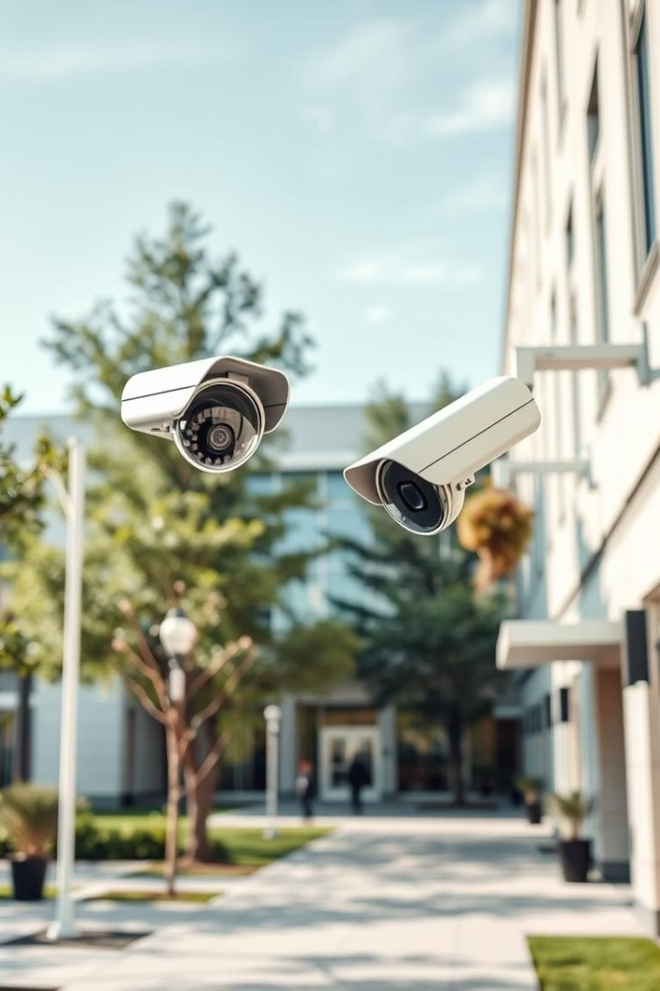
Future Directions
Real-World Deployment
Testing at universities and malls for live validation.
Voice Detection
Adding multilingual voice commands for help and stop.
Edge Computing
Deploying on low-cost devices like Raspberry Pi.
Privacy Measures
Face blurring and federated learning to protect data.

